Slide 1
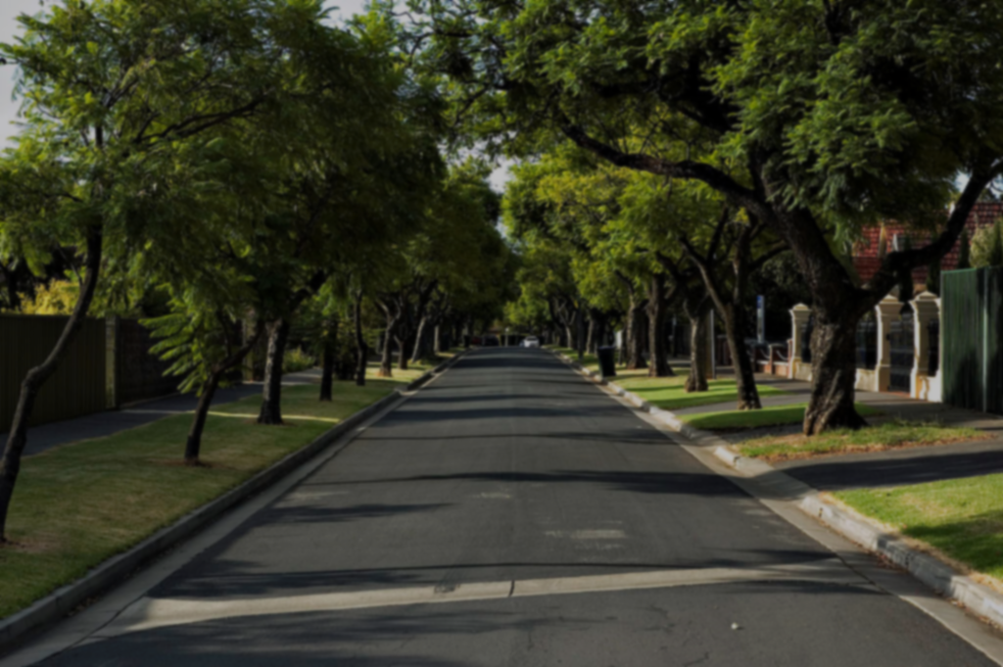

CITY OF Rockville SCOTT DRIVE AND VEIRS DRIVE Shared Used Path
Public Meeting
November 8, 2023
6pm – 7pm

Slide 2
Welcome and Introductions

Slide 3





Project design Team
City of Rockville DPW
Engineering Design Consultant
Montgomery County DOT
Maryland-National Capital Park and Planning Commission (Mandatory Referral)

Slide 4
Project Information

Slide 5
Project OVERVIEW
Feasibility Study
1.2 mile long Shared Use Path along Veirs Drive and Scott Drive
Safety Improvements for pedestrian and bicycles
to Robert Forest Middle School
Safety Improvements for pedestrian and bicycles
to Villages of Rockville senior community
Improve pedestrian and bicycle access and safety

Slide 6
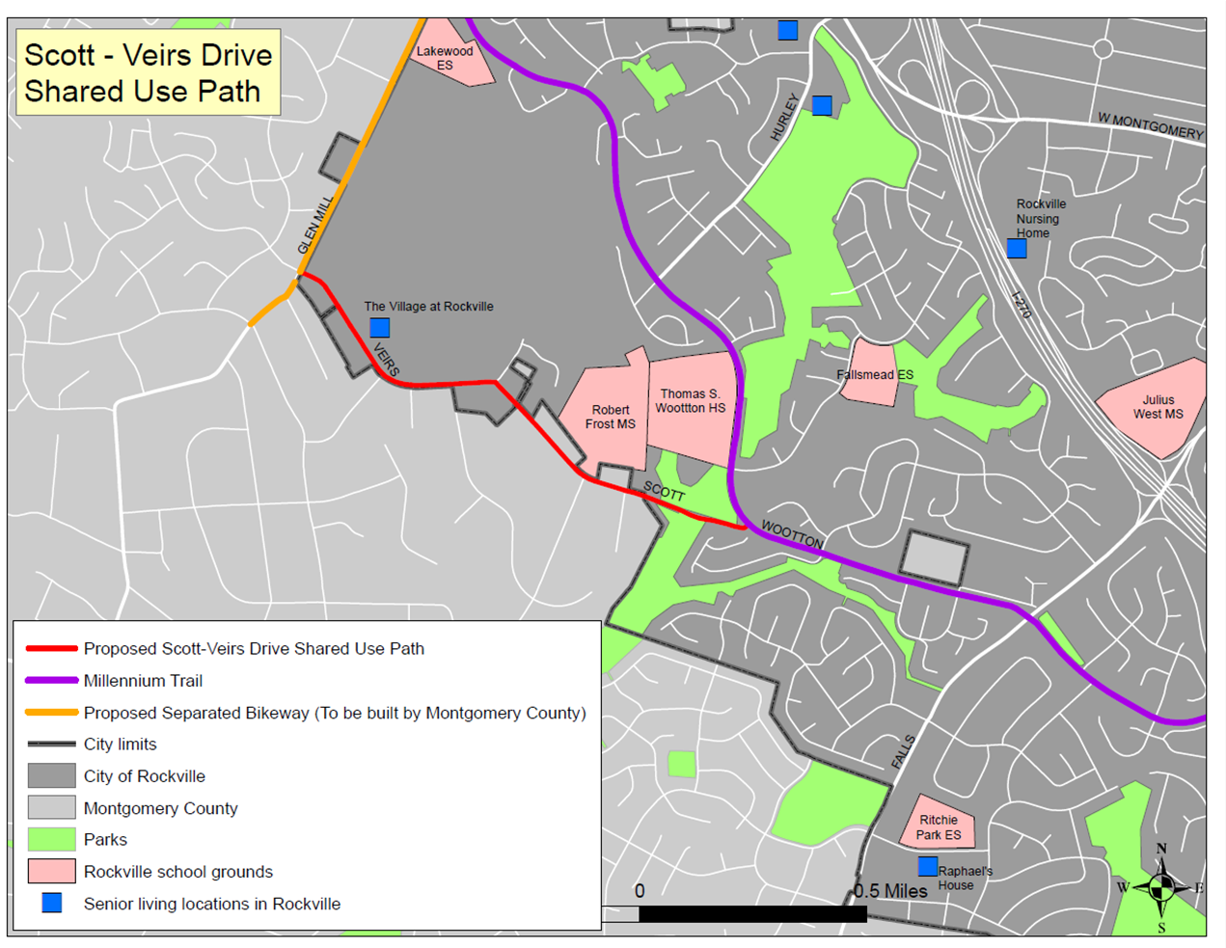
Project LOCATION
1.2 mile long corridor
Veirs Drive and Scott Drive from Glen Mill Road to Wootton Parkway
Proposed Scott –Veirs Drive Shared Use Path
Millennium Trail
Proposed Separate Bikeway (To be built by Montgomery County)
City Limits
City of Rockville
Montgomery County
Parks
Rockville School Grounds
Senior living locations in Rockville

Slide 7
Project GOALS / EXPECTATIONS
Minimize Utility Impacts
Minimize Right – of – Way Impacts
Minimize Impacts to Natural Resources
Connect Community To Millennium Trail
Improve pedestrian and bicycle access and safety

Slide 8
Feasibility Study
Shared Use Path along Veirs Drive and Scott Drive

Slide 9
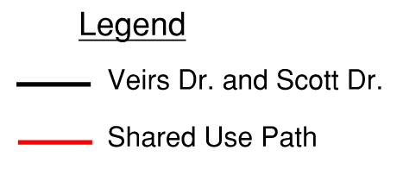
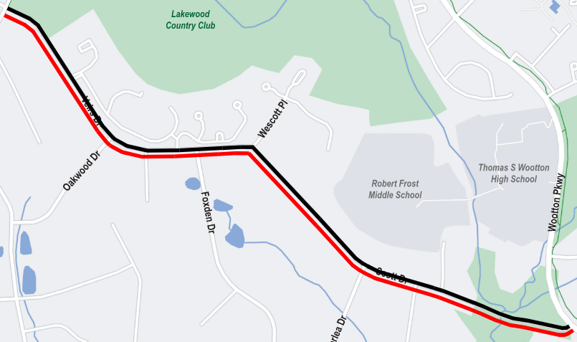
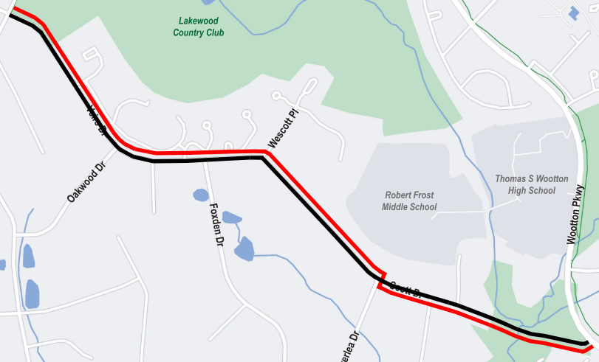
Alternatives
Alternative 1
Alternative 2

Slide 10
Alternative 1
Shared Use Path along the south side of the corridor

Slide 11
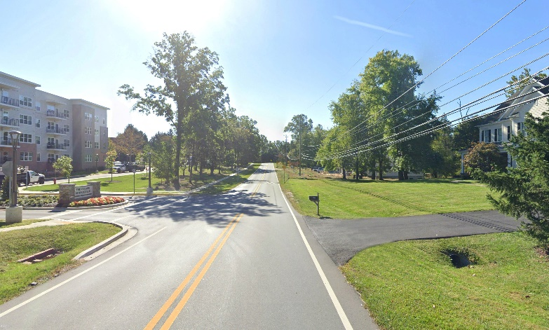
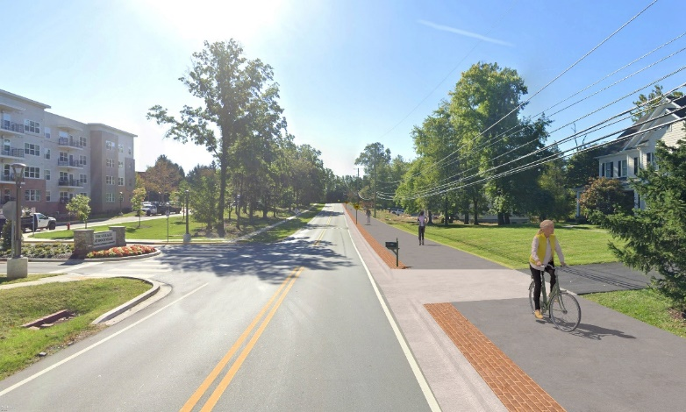
Alternative 1 – shared Use path along south side
Existing
Proposed
Veirs Drive at
The Village at Rockville

Slide 12
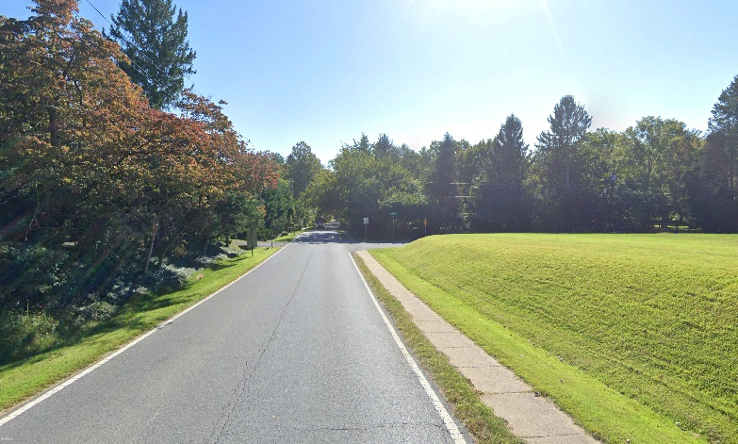
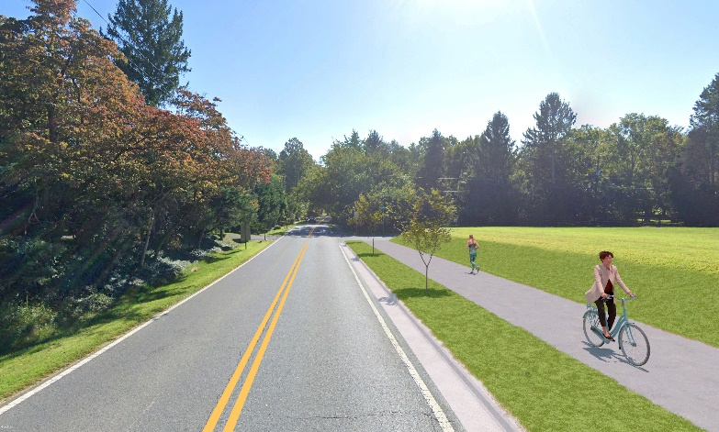
Alternative 1 – shared Use path along south side
Existing
Proposed
Scott Drive looking
towards Carriage Court

Slide 13
Alternative 2
Shared Use Path along north side of corridor with crossing to south side of corridor at Overlea Drive

Slide 14
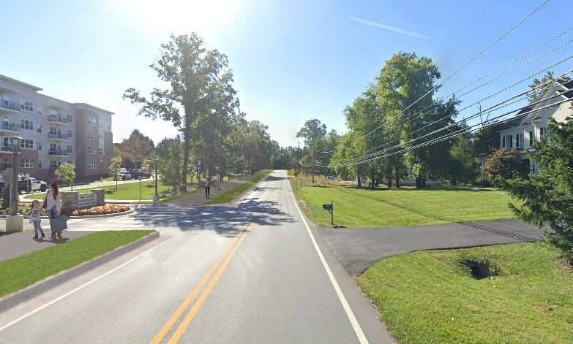
Alternative 2 – shared Use path along north side, crossing to south side at overlea drive
Existing
Proposed
Veirs Drive at
The Village at Rockville

Slide 15
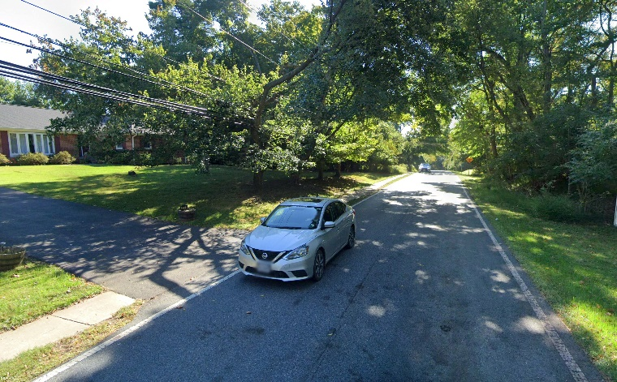
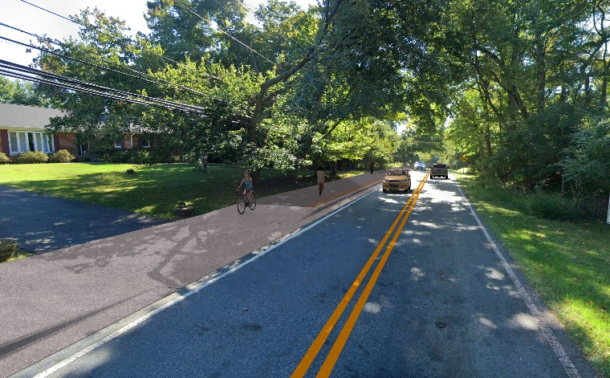
Alternative 2 – shared Use path along north side, crossing to south side at overlea drive
Existing
Proposed
Scott Drive
North of Overlea Drive

Slide 16
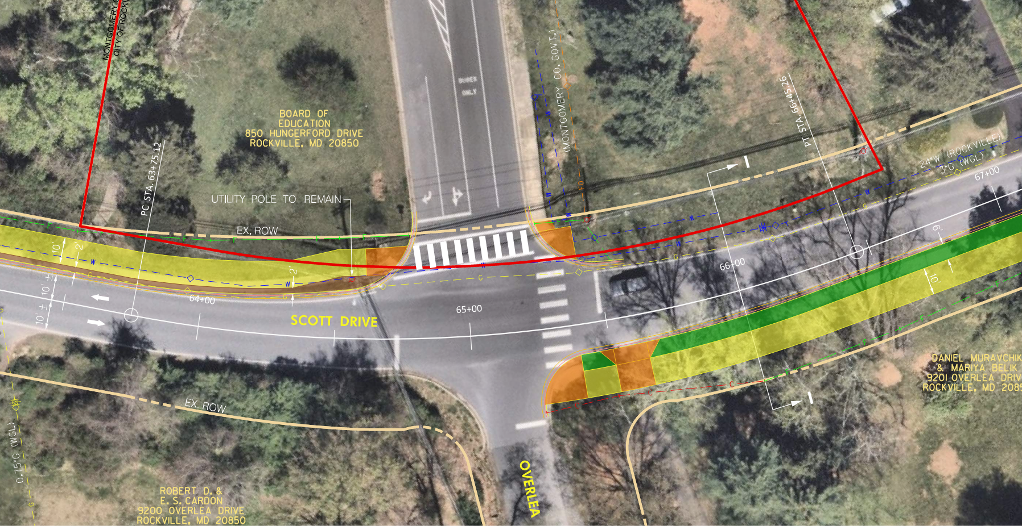
Alternative 2 – shared Use path along north side, crossing to south side at overlea drive
Scott Drive looking
towards Carriage Court

Slide 17
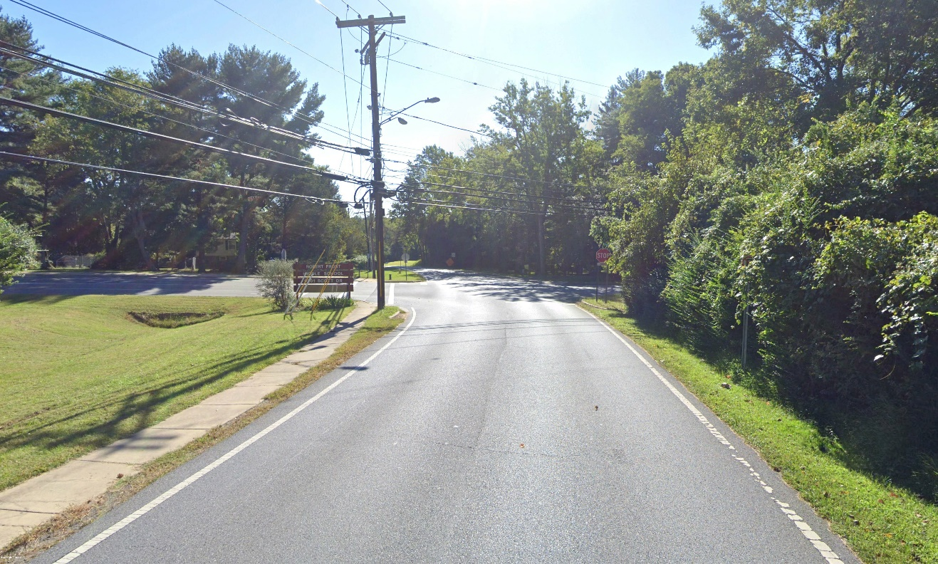
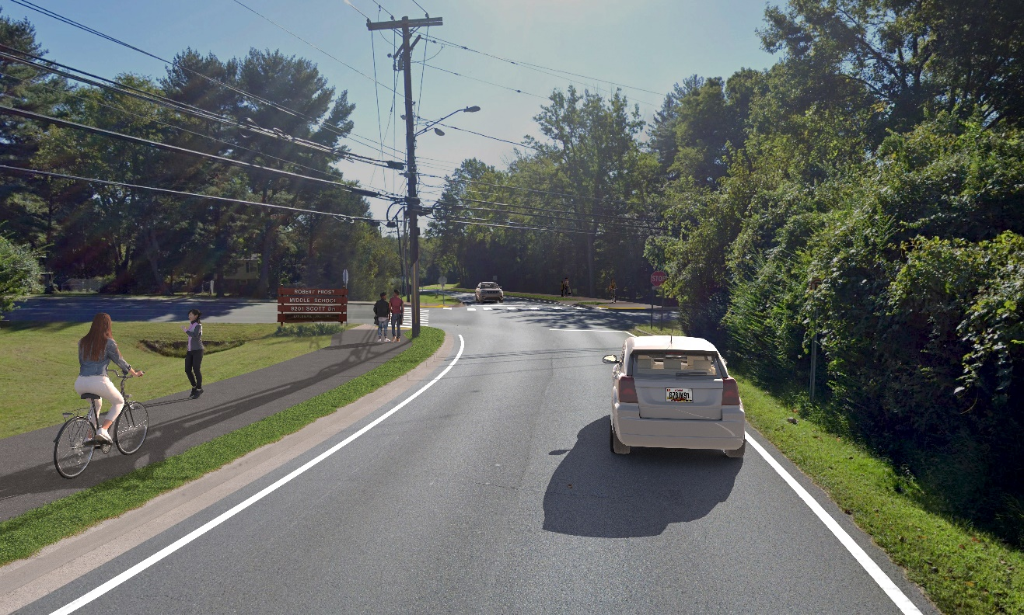
Alternative 2 – shared Use path along north side, crossing to south side at overlea drive
Existing
Proposed
Scott Drive
Overlea Drive Crossing

Slide 18
Alternative 2 – shared Use path along north side, crossing to south side at overlea drive
Existing
Proposed
Scott Drive looking
towards Carriage Court

Slide 19
Next Steps
Collect Public Comments
November 2023
Selected Preferred Alternative
December 2023
Prepare Feasibility Report
January 2024
Secure Funding for Detailed Design and Construction
May 2024

Slide 20
Questions?
Contact Information:
Jennifer Wang, PE, PTOE, PMP
Senior Transportation Engineer
Department of Public Works
City of Rockville
jwang@rockvillemd.gov
(240) 314-8506
Alternative Concept Plans are available for review at
https://www.rockvillemd.gov/689/Sidewalks

